Slide 1
Program Assessment Review In Transition Follow-Up Session
October 3, 2023

Slide 2
Agenda
Welcome and Introductions
Review each Program Assessment Review (PAR) in Transition section
Remind all on expectations
See rubric results
View a few exemplars
Consider opportunities for improvement
Highlight changes
Next Steps
Preview the 2023-24 PAR in Nuventive
Review timeline
Questions and answers (throughout the entire session)

Slide 3
PAR in Transition (Annual Report)
Five major sections:
Introduction - Table 1 and narrative
Program Student Learning Objectives (Intended Results) – Table 2
Curriculum Map – Table 3
Assessment Grid – Table 4 and narrative
Summary and Action Plan - narrative
Notes:
The PAR or annual report includes these five major sections which outline this portion of the workshop and slide deck. And, we will review each one starting with the introduction.

Slide 4
Introduction – Table 1
Complete Table 1: Program List below (and remove example) for each degree program, concentration, track, minor, and certificate.
Give brief overview of the degree program, concentration, track, minor, and certificate including any unique features or innovative pedagogy.
Table 1: Program List
Program | Type (e.g., degree, minor, certificate) | Degree Award (e.g., BS, BA, MS, MED, DNP) | Delivery Method(s) (e.g., F2F, 100% online, ITV, Multi-modal)
Examples: Criminal Justice | Degree | BS | F2F, online, multi-modal

Slide 5
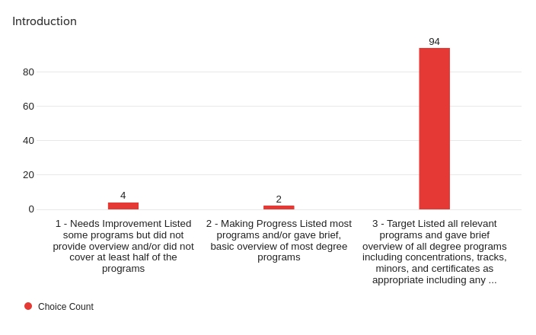
Introduction – Rubric Scoring
A good introduction included program name, type, degree award, modality, and a program description

Slide 6
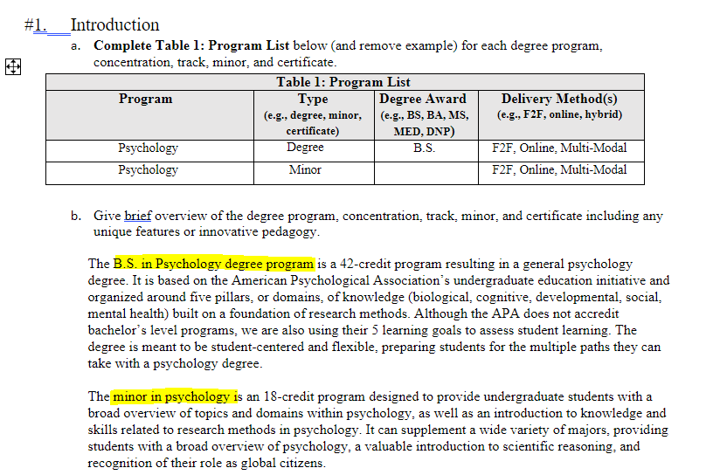
Introduction– Exemplars

Slide 7
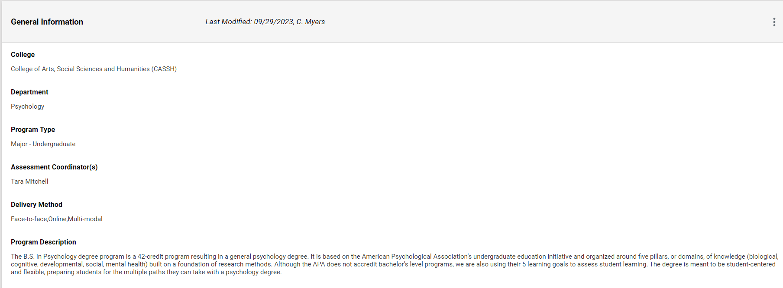
Introduction–Opportunities for Improvement
Include all elements for Introduction and Table 1 separately for each program in PAR in Transition (if not completed one yet) or review/update General Information on Nuventive moving forward
Screenshot of General Information
from Nuventive

Slide 8
Program Learning Objectives – Table 2
Table 2: Program Student Learning Objectives and Rationale
Program | Program SLOs | Action (indicate if SLO new, retained, revised from previous curriculum at any campus) | Results (summarize assessment outcomes or observed knowledge, skills, attitudes, and habits that informed action) | Rationale (provide brief statement of what informed the selection of the SLO)
Example: BS, Criminal Justice | SLO1: Communicate effectively in writing by stating purpose, organizing ideas, and using effective search strategies | Retained | Students met each criterion in Spring 2021 writing assessment for purpose (96%) and content (85%) but did not meet on organization (70%) and conventions (68%) (data on SharePoint) | Links to GE Competency, benchmarks to AACU and disciplinary standards, students below expectation scores on organization and writing conventions

Slide 9
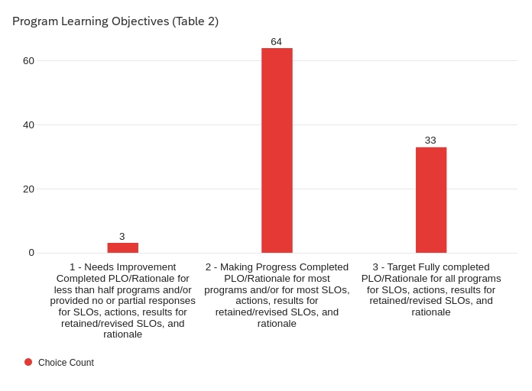
Program Learning Objectives – Rubric Scoring
Table 2 should have SLOs explicitly stated for each program, results provided for retained /revised SLOs, and a complete rationale provided

Slide 10
Program Learning Objectives – Exemplars
Table 2: Program Student Learning Objectives and Rationale
Program | Program SLOs | Action (indicate if SLO new, retained, revised from previous curriculum at any campus) | Results (summarize assessment outcomes or observed knowledge, skills, attitudes, and habits that informed action) | Rationale (provide brief statement of what informed the selection of the SLO)
B.S. in Psychology | SLO1: Knowledge Base in Psychology | Retained | In Spring 2022, on a cumulative PSYC100 exam, 37/44 (84%) scored 70% or higher, indicating acceptable levels of an introductory level of knowledge in psychology | The American Psychological Association recommends all undergraduate programs have this as a learning goal.
 | SLO2: Scientific Inquiry and Critical Thinking | Retained | In Spring 2022, on a Research Methods exam, 23/36 (72%) of students scored a 70% or higher. | In addition to linking to the GE competency of Natural World, the American Psychological Association recommends all undergraduate programs have this as a learning goal.
 | SLO3: Ethical and Social Responsibility in a Diverse World | Retained | Ethical Responsibility: In Fall 2021, 36/37 (98%) students completing a plagiarism in scientific writing quiz in PSYC204 met or exceeded a score of 70%. Social Responsibility: In Spring 2022, 49/56 (88%) students in Forensic Psychology completing a reflection of bias and discrimination met or exceeded a score of 70% | The American Psychological Association recommends all undergraduate programs have this as a learning goal.

Slide 11
Program Learning Objectives – Exemplars
Table 2: Program Student Learning Objectives and Rationale
Program | Program SLOs | Action (indicate if SLO new, retained, revised from previous curriculum at any campus) | Results (summarize assessment outcomes or observed knowledge, skills, attitudes, and habits that informed action) | Rationale (provide brief statement of what informed the selection of the SLO)
Minor in Psychology | SLO1: Knowledge Base | Retained | In Spring 2022, on a cumulative exam in PSYC100, 37/44 (84%) scored 70% or higher, indicating acceptable levels of an introductory level of knowledge in psychology | Although the minor is designed to be flexible, this SLO is introduced in the course required for all minors (PSYC100)
 | SLO2: Scientific Inquiry | Retained | In Spring 2022, on an exam covering the scientific method and psychological research, 41/45 (91%) of students scored 70% or higher | Although the minor is designed to be flexible, this SLO is introduced in the course required for all minors (PSYC100)
 | SLO3: Ethical and Social Responsibility | Retained | In Spring 2022, 42/45 (93%) of students scored 70% or higher on a reflection of the role of cultural norms in their behavior | Although the minor is designed to be flexible, this SLO is introduced in the course required for all minors (PSYC100)

Slide 12
Program Learning Objectives – Opportunities for Improvement
Include all elements for Table 2 separately for each program (e.g., major, tracks, minor) in PAR in Transition (if not completed one yet) – Table 2 will not be used in Nuventive
Use Opportunities for Improvement on Table 2 to inform Table 4 Assessment Grid in Nuventive
Provide SLOs for each program and clearly indicate to which program the SLOs belong
Provide at least one unique SLO for each program where the core may be the same or similar (e.g., major and tracks)
Report raw data plus percent that met/did not meet expectations

Slide 13
Curriculum Map – Table 3
Table 3: Curriculum Map Template
Program Student Learning Objectives (SLO) | SLO | SLO | SLO | SLO | SLO | SLO | SLO | SLO | SLO
Program Requirements
Intro to CJ | I | I
CJ Capstone | R, S | R, S
Course
Course
Course
Electives Category
Experiential Learning
Other
Abbrev. | Description
I | Introduced or Introductory Level | (i.e., B = Beginning in BU grid)
R | Reinforced | (i.e., I = Intermediate in BU grid)
S | Summative or Mastered | (i.e., A = Advanced in BU grid)
Note: Enter in each cell the appropriate designation (i.e., introduced, reinforced, or summative) for how each SLO is represented in a given course

Slide 14
Curriculum Map– Rubric Scoring
Table 3 shows SLOs explicitly stated for each program and adequate coverage of I,R,S for each SLO

Slide 15
Curriculum Map – Exemplars
Program Core Program Student Learning Objectives (SLO) | 1.Professionalism: Graduates will demonstrate: (a) knowledge of the mental health counseling field’s history and development, (b) commitment to the counseling professional identity through active membership and participation in professional organizations as well as maintaining ethical, legal, and professional behavior according to the current edition of the ACA Code of Ethics, and (c) a commitment to their own self-care and wellness. | 2.Assessment & Treatment Planning: Graduates will demonstrate the knowledge, skills, and practices to competently complete assessments, case conceptualizations, diagnoses (using both the DSM-5TR and the ICD-10), and treatment plans across the lifespan. | 3. Counseling, Prevention, & Intervention: Graduates will demonstrate knowledge, skills, and practices of effective culturally appropriate individual, group, couples, and family counseling skills. | 4.Diversity and Advocacy: Graduates will respect and value the dignity of people across all cultural contexts. They will demonstrate knowledge, skills and practices to competently advocate for clients and the profession as well as understand how to influence policy to enhance the professional practice of counseling including prevention of mental and emotional disorders. | 5.Scholarship: Graduates will demonstrate current knowledge, skills, and use relevant research findings to critically evaluate programs and inform practice.
Program Requirements
CMHC505 | I (Professional Journey Paper) |  |  | I (Professional Journey Paper)
CMHC515 |  | I (Biopsychosocial and Mental Status Exam Demonstration & Interpretation)
CMHC520 |  | I (Final Project)
CMHC525 |  |  | I (Final CCS-R)
CMHC530 |  |  |  |  | I (Systematic Program Evaluation)
CMHC535 |  |  |  | R (Cultural Exploration & Advocacy Plan)
CMHC550 |  | R (Final Movie Review)
CMHC555 |  | R (Treatment Plan) | R (Final CCS-R) |  | R (Treatment Plan)
CMHC560 |  |  | R (Case Study)
CMHC565 |  |  | R (Final CCS-R)
CMHC585 | R (Final Oral Exam)
CMHC595 | S (CACREP Program Outcomes Survey Internship II Site Supervisors) | S (CACREP Program Outcomes Survey Internship II Site Supervisors) | S (CACREP Program Outcomes Survey Internship II Site Supervisors) | S (CACREP Program Outcomes Survey Internship II Site Supervisors) | S (CACREP Program Outcomes Survey Internship II Site Supervisors)
CMHC596 | S (CACREP Program Outcomes Survey Internship II Site Supervisors) | S (CACREP Program Outcomes Survey Internship II Site Supervisors) | S (CACREP Program Outcomes Survey Internship II Site Supervisors) | S (CACREP Program Outcomes Survey Internship II Site Supervisors) | S (CACREP Program Outcomes Survey Internship II Site Supervisors)

Slide 16
Curriculum Map – Exemplars
General Track Program Student Learning Objectives (SLO) | 1.Appraise key differences between counseling children, adolescents, and adults in the counseling process to include ethical and legal considerations. | 2.Assess children and adolescent needs to identify various disorders diagnoses that are common in both the children and adolescent population. | 3.Apply evidence-based strategies and interventions to address common diagnoses among children and adolescents. | 4. Identify strategies, approaches, and barriers to working with parents, guardians, school professionals, and other entities that can make up a multidisciplinary team of children and adolescents. | 5.Students will apply the cultural context of relationships, issues, and trends to the military population. | 6.Students will apply resiliency models to Veterans and their families. | 7. Students will identify diverse challenges and mental health needs that may impact the Veteran population. | 8. Students will utilize prevention, intervention, consultation, education, and advocacy programs to promote positive mental well-being for veterans and their families. | 9. Students will identify current literature on effective theories, techniques, and interventions and apply the information in working with veterans and their families. | 10.Students will identify community resources available to assist military veterans and/or their families within their community
Program Requirements
CMHC562 | I (Final Project) | I (Final Project) | I (Final Project) | I (Final Project)
CMHC564 |  |  | R (Case Application)
CMHC575 |  |  |  |  | I (Case Study #1) | I (Case Study #1) | I (Case Study #2) |  |  | I (Community Resource Pamphlet)
CMHC580 |  |  |  |  |  |  |  | R (Partner Presentation) | R (Case Study)

Slide 17
Curriculum Map– Opportunities for Improvement
Provide mapping for each program included in the PAR
Show progression of learning throughout curriculum
Ensure all SLOs mapped to at least one course/learning activity
Ensure mapping includes all proficiency levels (I,R,S/M) for all SLOs as appropriate to program level (e.g., major v. minor)
Label SLOs instead of just SLO1, SLO2
Use CU naming conventions (I,R,S/M) – Nuventive will be set up this way
Review for accuracy in Nuventive and provide areas for which information was unavailable

Slide 18
Assessment Grid (Plan) - Table 4
Program Type, Underline One: Degree Program, Concentration, Track, Minor, Certificate |  | Program Coordinator: Department Chair: |  | Date Submitted:
Student Learning Objectives | Student Assessment | Results* | Actions* | Closing the Loop*
1. | Method/assessment: (e.g., tests, presentations, research paper, etc.) Criterion/performance target: When and how often does assessment occur? | Criterion/performance target met: [ ] Yes [ ] No [ ] N/A Results and analysis: | Actions taken to improve student performance | Changes in student performance when re-assessed
2. | Method/assessment: (e.g., tests, presentations, research paper, etc.) Criterion/performance target: When and how often does assessment occur? | Criterion/performance target met: [ ] Yes [ ] No [ ] N/A Results and analysis: | Actions taken to improve student performance | Changes in student performance when re-assessed
3. | Method/assessment: (e.g., tests, presentations, research paper, etc.) Criterion/performance target: When and how often does assessment occur? | Criterion/performance target met: [ ] Yes [ ] No [ ] N/A Results and analysis: | Actions taken to improve student performance | Changes in student performance when re-assessed
* Not required to complete c. – e. in 2022-23 since this is a planning document for the integrated curriculum or revised stand-alone programs

Slide 19
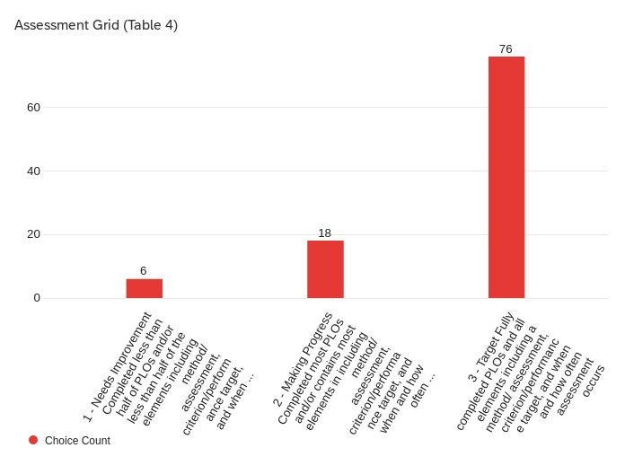
Assessment Grid (Plan)– Rubric Scoring
Table 4 states SLOs explicitly for each program and identifies assessment methods, criteria, and when/how assessed

Slide 20
Assessment Grid (Plan) – Exemplars
Program Type, Underline One: Degree Program, Concentration, Track, Minor, Certificate CMHC |  | Program Coordinator: Kristin Vincenzes Department Chair: Thomas Starmack |  | Date Submitted: 5/31/23
Student Learning Objectives | b. Student Assessment | c. Results (Outcomes)* | d. Actions* | e. Closing the Loop*
1. Professionalism: Graduates will demonstrate: (a) knowledge of the mental health counseling field’s history and development, (b) commitment to the counseling professional identity through active membership and participation in professional organizations as well as maintaining ethical, legal, and professional behavior according to the current edition of the ACA Code of Ethics, and (c) a commitment to their own self-care and wellness. | Method/assessment: (e.g., tests, presentations, research paper, etc.) (1) Internship II CACREP Program Outcomes Survey (2) National Counselor Exam (NCE) Criterion/performance target: (1) Site supervisors will complete a site supervisor evaluation for all students at the completion of Internship II. Site supervisors will score the students on a minimum of a 4 (meets expectations) (2) NCE: Students will either pass the exam or be within 1 SD of the National Mean. When and how often does assessment occur? (1) Internship II CACREP Program Outcomes Survey: Fall, Spring, Summer (2) NCE: Fall & Spring | Criterion/performance target met: [] Yes [ ] No [ ] N/A Results and analysis: | Actions taken to improve student performance | Changes in student performance when re-assessed
2. Assessment & Treatment Planning: Graduates will demonstrate the knowledge, skills, and practices to competently complete assessments, case conceptualizations, diagnoses (using both the DSM-5TR and the ICD-10), and treatment plans across the lifespan. | Method/assessment: (e.g., tests, presentations, research paper, etc.) (1) Internship II CACREP Program Outcomes Survey (2) National Counselor Exam (NCE) Criterion/performance target: (1) Site supervisors will complete a CACREP Program Outcomes Survey for all students at the completion of Internship II. Site supervisors will score the students on a minimum of a 4 (meets expectations) (2) NCE: Students will either pass the exam or be within 1 SD of the National Mean. When and how often does assessment occur? (1) Internship II CACREP Program Outcomes Survey: Fall, Spring, Summer (2) NCE: Fall & Spring | Criterion/performance target met: [] Yes [ ] No [ ] N/A Results and analysis: | Actions taken to improve student performance | Changes in student performance when re-assessed
Columns c. – e. were not required in 2022-23, but programs will be asked to enter this information in Nuventive for 2023-24

Slide 21
Assessment Grid (Plan) – Exemplars
Program Type, Underline One: Degree Program, Concentration, Track, Minor, Certificate PSYCHOLOGY |  | Program Coordinator: Department Chair: |  | Date Submitted:
Student Learning Objectives | Student Assessment | Results* | Actions* | Closing the Loop*
1. SLO 1: Knowledge Base in Psychology | Method/assessment: Knowledge Base in Psychology will be assessed through Senior Seminar (PSYC406) performance. Criterion/performance target: Having 70% or more of students rated as meeting or exceeding expectations for their senior seminar project (which will vary by section). When and how often does assessment occur? This SLO will be measured starting in Fall 2023. Data will be provided from each campus based on students’ in senior seminar from at least one semester of each academic year. | Criterion/performance target met: [ ] Yes [ ] No [ ] N/A Results and analysis: | Actions taken to improve student performance | Changes in student performance when re-assessed
2. SLO 2: Scientific Inquiry and Critical Thinking | Assessment 1: Method/assessment: Scientific Inquiry and Critical Thinking will be assessed in Research Methods (PSYC250) through performance on a final exam. Criterion/performance target: Having 70% or more of students score 70% or higher on the final exam. When and how often does assessment occur? This SLO will be measured starting in Fall 2023. Data will be provided from each campus based on student performance on a final exam from at least one semester of each academic year. Assessment 2: Method/assessment: Scientific Inquiry and Critical Thinking will be assessed through evaluation of student research in PSYC350 (Research Lab). Criterion/performance target: Having 70% or more of students meet or exceed expectations on an evaluation of their research project. When and how often does assessment occur? This SLO will be measured starting in Fall 2023. Data will be provided from each campus based on students’ in PSYC350 from at least one semester of each academic year. | Criterion/performance target met: [ ] Yes [ ] No [ ] N/A Results and analysis: | Actions taken to improve student performance | Changes in student performance when re-assessed
Columns c. – e. were not required in 2022-23, but programs will be asked to enter this information in Nuventive for 2023-24

Slide 22
Assessment Grid (Plan) – Opportunities for Improvement
Provide SLOs for each program and clearly indicate to which program the SLOs belong
Specify at least one unique SLO for each program (e.g., tracks within majors should have at least one unique SLO apart from the core)
Indicate what assessment method is used – best practices point to having multiple methods of assessment
Include more information about criteria for success (what % of students should earn what % score or what rating)
Include raw data and percent met

Slide 23
Summary and Action Plan
Four primary parts:
Summarize the program’s data and trends for the three campuses. Please see the Program Review Data Dashboards - https://www.bloomu.edu/program-assessment and other Institutional Research Dashboards as needed - https://www.bloomu.edu/institutional-research for program, college, and institutional data
Identify the integrated program’s strengths and weaknesses
Provide a summary of personnel, physical, technology, and financial resources and adequacy of those resources
Provide an action plan for next academic year [3-5 bullet points based on program data, student learning outcomes (observed results), resource sufficiency, or other internal/external sources of information/data]

Slide 24
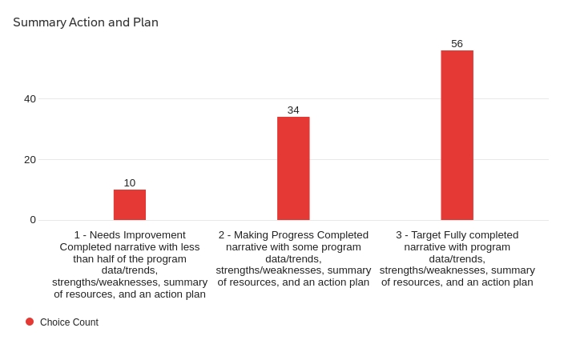
Summary and Action Plan - Rubric Scoring
Section 5 includes an analysis of a cross-section of program data, strengths / weaknesses derived from the data, resources identified, and actions that link to data

Slide 25
Summary and Action Plan– Exemplars
Refer to examples

Slide 26
Summary and Action Plan– Opportunities for Improvement
Address all parts (a-d) with sufficient detail to demonstrate data analysis and linkage to findings
Analyze data available through program and institutional dashboards
Augment internal program data with external sources where available
Complete as a requirement for submission in Nuventive

Slide 27
Next Steps
Complete build out of Nuventive Premier Solutions (see demo by Shane Jones)
Distribute Program Assessment Review (PAR) / Nuventive User Guide (eliminated Table 2 altogether and modified other sections)
Hold winter/spring training sessions and one-on-one meetings
Receive feedback and refine materials
Send reminders about May 31 due date to post assessment results for 2023-24 in Nuventive

Slide 28
Questions

