Slide 1
Social Work Internships
For a more extensive list, please view the Field Education link on the BU social work website

Slide 2
Internships Completed 2017-2019

Slide 3
Children and Families/ Schools
ADERS, Inc (Autism)Montoursville (570-523-6787)
Behavioral Health Services, Inc: Danville (570-275-1380)
Bloomsburg University Trio Upward Bound (570-389-4272 )
Boys and Girls Club Philadelphia (215-438-7394)
Bucks County Children and Youth (215-348-6900)
Bucks County Intermediate Unit (215-348-2940)
Clear Vision Residential: Montgomery PA (570-547-2810)
Columbia County Family Center (570-387-9086)
Central Columbia School District (570-784-2850)
Diversified Treatment Associates (DTA) (570-437-9145)
Families United Network, Inc: Montoursville (570-651-9016)
Hazleton Children and Youth (570-826-8710)
Head Start –Bloomsburg ( 570-784-8570); Danville (271-3268)

Slide 4
Institute for the Development of African American Youth (IDAAY): Philadelphia (215-235-9110)
Kidspeace: Danville (570-271-0590)
Lewisburg High School (570-522-3223)
Millville School District (570-784-8040)
New Story Selinsgrove (570-884-3615 ) Berwick
Montour County Children and Youth (570-271-3050)
Northampton County Children and Youth (610-762-4380)
Northumberland County Children and Youth(570-988-4237)
Shamokin Area School District (570-648-5731)
Snyder County Children and Youth (570-374-4570)
Southern Columbia School District(570-356-4301)
Sullivan County Children and Youth (570-928-0307)
Valley Youth House: Philadelphia (215-925-3180)

Slide 5
Drug and Alcohol
Mental Health & ID
Columbia County Drug Court (570-389-5670)
Genesis House: Danville (215-784-4073)
Banyan/Clearbrook Treatment Centers: Pottsville (570-341-8145)
Guadenzia: Berwick PA (570-752-2985)
DAWN (BU Campus)
Danville State Hospital (570-849-2044)
CMSU (Columbia, Montour, Snyder and Union County) (570-275-5422)
Concern Counseling (570-522-0990)
RHD-FASST Connections (Homelessness) (267-331-8164)
EOS Therapeutic Riding Center: Bloomsburg ( 570-784-5445)
Reaching Beyond Limits (ID): Kingston, PA (570-763-5026)

Slide 6
Aging
Berwick Retirement Village ( 570-317-2210)
Bloomsburg Health Care Center (570-784-5930)
Columbia/Montour Aging Office (570-784-9272)
Columbia County Senior Centers (570- 784-9272)
Emmanual Nursing Home: Danville (570-275-6100)
Kreisher & Gregorowicz Law: Bloomsburg (570-784-5211)
Northumberland County Aging Office (570-495-2395)
Snyder/Union Aging Office (570-524-2100) (374-5558)
The Gardens at Millville (570-458-5566)
Willow Valley Communities: Lancaster (717-464-6803)

Slide 7
Mezzo/Macro and Community Based Internships
AGAPE: Bloomsburg (570-317-2210)
BU Center For Community Research
Columbia County Victim Witness Coordinator
CommUnity Zone Lewisburg PA (570-238-1818)
Columbia County Democratic Committee (570-387-6470)
Friendship House: Scranton (570-342-8305)
Gatehouse (homeless shelter) Danville (570-275-6766)
THIS (Harrisburg Capitol Policy Internship) See Dr. Erdley
The Women’s Center: Bloomsburg (570-784-6632)
BU Women’s Resource Center (570-389-5283)
United Way of Columbia County (570-784-3134)
SMILE (single moms) (570-752-1354)

Slide 8
Medical Social Work
See Dr. Erdley before contacting hospitals for a medical social work internship
Geisinger Psychiatric Outpatient Program
Geisinger Psychiatric Inpatient Program
Geisinger Health Plan Community Health Advocate
Geisinger Maternal Fetal Medicine
Geisinger Social Work Case Management
Lehigh Valley Cedar Crest Hosptial
UPMC: Williamsport
Crozer Keystone Health System (610-497-7606)
Ronald McDonald House: Danville (570-214-1792)

Slide 9
Corrections/Law/Probation/Politics
Justice Works (570-567-7438)
NASW-PA (PACE)
North Central Secure Treatment Unit: Danville (570-271-4734)
THIS (The Harrisburg Internship): Apply up to a year prior to scheduled internship: http://www.passhe.edu/inside/ASA/THIS/Pages/default.aspx
The Washington Center (Policy and social justice): (202-238-7900) www.twc.edu

Slide 10
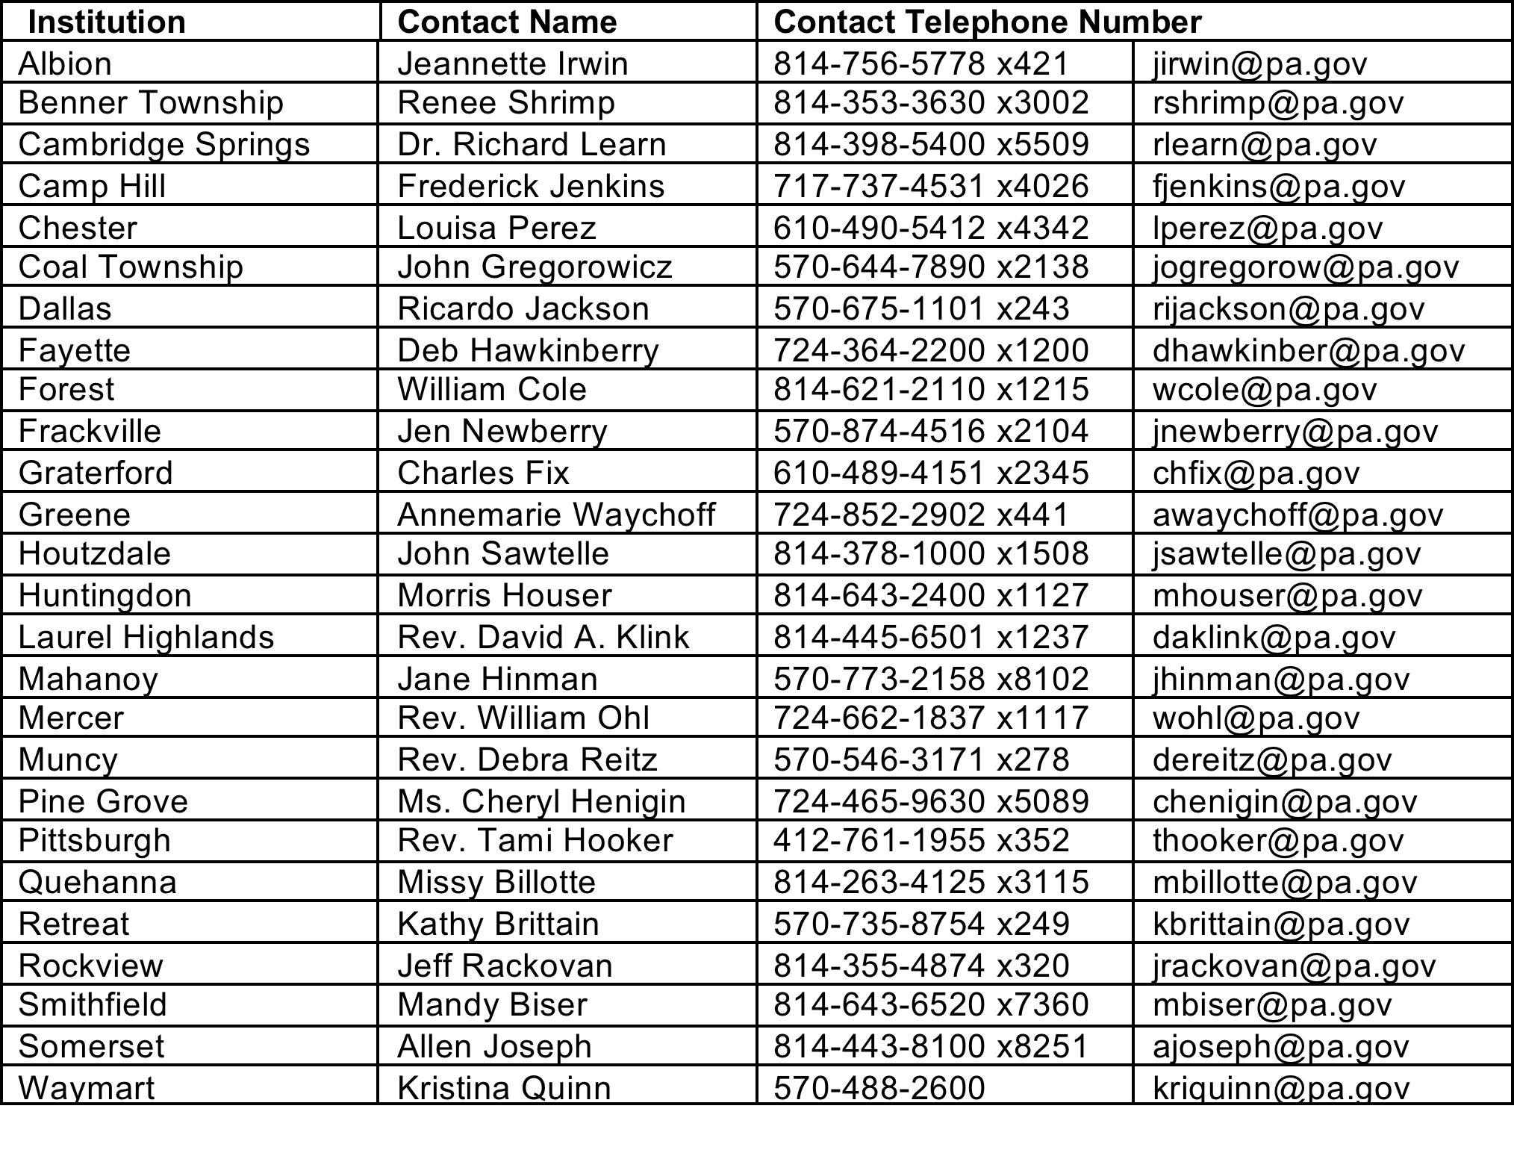
PA DEPARTMENT OF CORRECTIONS INTERNSHIP CONTACTS

Slide 11
Philadelphia Internships
Catholic Social Services, Mercy Hospice
Anti-Violence Partnership of Philadelphia
Carson Valley Children's Aid
Chester County Adult Probation
Chester County Department of Aging Services
Chester County Domestic Relations
Chester County Emergency Services
Children’s Hospital of Philadelphia (CHOP)
Crime Victims Center of Chester County
Crime Victims Center of Chester County
Easter Seals of Southeastern PA
Family Court of Philadelphia - Juvenile Probation Department
First Generation First Judicial District of Pennsylvania (FJD)
Friends Select School
Gift of Life
Interim House West
IDAAY(Institute for the Development of African American Youth)
Kaleidoscope Family Solutions Inc

Slide 12
Philadelphia Internships
Lehigh County Adult Probation and Parole
Montgomery County Adult Probation & Parole
Montgomery County Juvenile Probation (PA)
Montgomery County Youth Center
National Multiple Sclerosis Society - Greater Delaware Valley Chapter
Northampton County Juvenile Probation Office
NorthEast Treatment Centers
Northwest Victim Services
PA Coalition Against Domestic Violence
PA State Correctional Institute (SCI) - Chester
Philadelphia County Adult Probation and Parole Department
Philadelphia Freedom Valley YMCA
RHD Fasst Connection
YMCA Columbia North Branch
YMCA of Reading and Berks County
Youth Outreach Adolescent Community Awareness

Slide 13
Research and Grant Opportunities
Research Assistant- Positions available are based upon faculty need and available funding.
URSCA(Undergraduate Research, Scholarly, and Creative Activity) Faculty mentored summer research that includes part time and full time stipend support. www.intranet.bloomu.edu/ursca
PEG (Professional Experience Grant): Faculty mentored research, academic internships, study abroad, creative performance activities, service projects and attending a professional conference are considered. www.intranet.bloomu.edu/professionalu-grant

Slide 14
The Harrisburg Internship Semester (THIS)
If you are interested in public policy, THIS, provides a semester long internship at the Pennsylvania State Capitol with policy makers and leaders.
What you can expect:
15 credits toward your major
A $4000 stipend to assist with living expenses
To reside in Harrisburg with other students with similar career interests and make connections to last a lifetime
To learn more about public policy
Enhanced research, writing, speech, and program design and evaluation skills
Speak with Dr. Erdley-Kass if you are interested and review additional information at www.passhe.edu/inside/ASA/THIS

Slide 15
Child Welfare Education for Baccalaureates (CWEB)
The CWEB program is a cooperative effort among the US Administration for Children and Families and the PA DHS, and the 15 undergraduate social work degree programs in PA accredited by CSWE.
The goal of CWEB is to strengthen public child welfare services in PA by providing educational opportunities for social work undergraduates preparing for employment in one of the 67 PA public child welfare agencies.
Students qualified for this program must be a junior in one of the 15 accredited social work programs and have a sincere interest in child welfare studies; a satisfactory GPA and a recommendation from a social work faculty member.
Accepted students receive between 500 and 975 hours of extensive training between 1-2 semesters their senior year.

Slide 16
How to apply for CWEB
Meet with Dr. Erdley-Kass to confirm your interest and fit for the program.
Review the CWEB manual and Informational video found at www.socialwork.pitt.edu/researchtraining/child-welfare programs/child-welfare-education-baccalaureates (this can also be found on the BU social work website)
Be prepared to submit the following with your application: Current resume, faculty recommendation, academic transcripts, current driver’s license, personal statement
Benefits of CWEB: Extensive training, Educational Stipend and Tuition Benefits, Employment in a child welfare agency upon completion of the CWEB internship.

